Slide 1
Pillars of Effective Teaching
Improving student learning and teacher effectiveness
(this is not a pyramid scheme)

Slide 2
What can you do to improve your teaching?
4 aspects:
Physical environment
Time management
Instructional management
Teacher impact

Slide 3
Physical: Space and layout
Accessible to everyone
Efficient (non-disruptive to the lesson)
Encouraging the behaviours they are intended for
Eg. Blackboard arrangement
Explanation space
Student answers
Today in English Class:
Review quiz
Reading race
“-ing” verbs
“-ing” practice
Homework (if any)

Slide 4
Physical: Educational Technology
*Lessons should not be arranged around resources; resources should compliment the lesson!*
Resource | Effective | Ineffective
Slideshow | Use of pointers to direct attention, segmenting information, relevant multimedia content, recording student answers for later access, accessing pre-created information, visual impact | Disorganization/too many stimuli, information overload, visibility difficulties, no interaction
Music | Soundtracks, classical BGM for speaking activities to avoid “breaking the silence” anxiety | Loud, vocal-up, suspenseful, popular music that distracts
Graphic Organizers | Colour/shape-coded pictures, charts, information fragments that teachers/students can interact with for visual cues | Memes, size/colour/shape inconsistencies
Dice | Multi-option element of randomness in activities | “point” counters, unmatched number of options

Slide 5
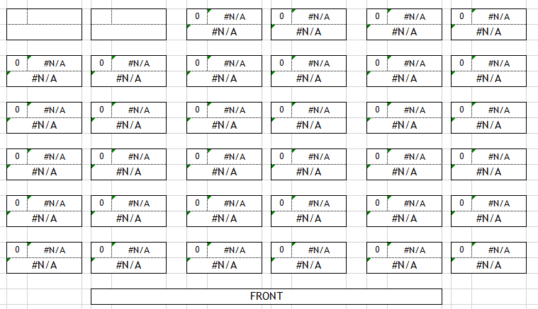
Physical: Seating arrangement
Traditional rows
Pros:
Reinforces classroom management (disruptions less likely)
Conducive to independent work
Improved teacher behaviour
Cons:
Only students in front/middle engaged
Isolating (does not promote interaction)
Harder to remember students
Passive classroom

Slide 6
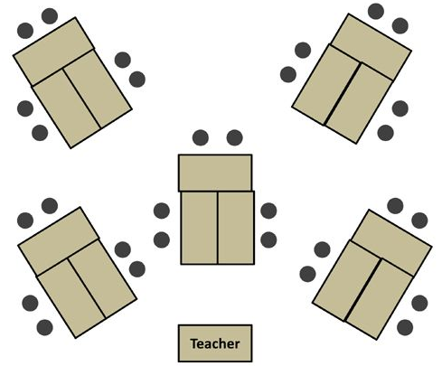
Physical: Seating arrangement
Pros:
Good for discussion/peer assistance
Conducive to group work/ participation
Active classroom
Easy mobility
Cons:
Encourages disruption
Hard to monitor / manage
Likely needs to be set up specifically for lesson
Some students always facing away/rotating
NG for individual /full-class activities
Students in back not engaged
Groups

Slide 7
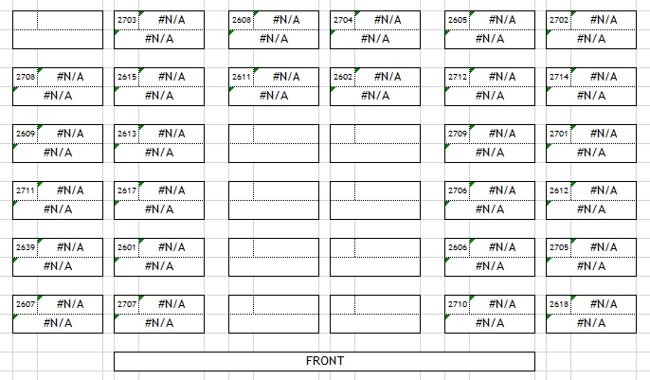
Physical: Seating arrangement
Pros:
Easy to arrange pairs (vertical/horizontal)
All desks facing front means work is still individual
No concentrated area of participation
Cons:
Students in front row get nervous
Isolating (does not promote interaction)
Teacher movement limited
Students constantly have to rotate in seats/move with little room
U-shape

Slide 8
Physical: Tips
Include your seating arrangement in your lesson plan. If it’s consistent across lessons, ask students to arrange class before lesson. If ALT/OTE can get to class before the bell, start rearranging desks.
Try to encourage the school to cover the legs of desks/chairs with tennis balls or chair socks, or ask students to pick up desks when moving. Loud transitions are distracting (and bad for those with noise sensitivity).
Build habits and routines. Using the same resources / activities frequently in different lessons will make transitions more efficient.
Encourage students to keep their desks free of clutter: have on it only what they need in that lesson, and everything they need that lesson. No looking for a pencil / book walls to sleep behind.
TOP

Slide 9
Time: Pacing
Plan review activities for the end of lessons: comprehension check takes less time and can achieve the most important goal: understanding
Check your lesson plan for what is most important. Move it as early in the LP as you logically can
Leave time for questions or re-explaining. Better to have backup comprehension activities to reinforce learning then rush through content
Notes:
It is more important for students to understand something well and the content to spill over into the next lesson than to rush through the content at the expense of student understanding. I learned this the hard way. I rushed though peer editing. Paragraph building, the academic rules of writing and teaching them to use the computers before the midterm so I would have enough to test them on, and ending up getting such a low class average. On top of that, I heard from upper year students that their kouhai who are in my class say my class is ridiculously difficult and they often feel lost. Lastly, while I stressed the importance of not plagiarizing in at least three lessons, gave them wordy detailed handouts about it, and explained it as simply as I could, I still had two cases of students plagiarizing on their first essay assignment, had to give them both zeros, and sat in a meeting with their crying selves explaining it again in English, while their homeroom teacher chewed them out in Japanese. It wasn’t pretty and I reformed my schedule, cut out a lot of small stuff, and set a much slower, more adjustable pace for term two.

Slide 10
Time: Cognitive Capacity
Spare Cognitive Capacity
Primary Task Cognition
Notes:
I’m sure you’ve all had those lessons that you put so much work into only to find that they were too complicated or detailed for your class; a couple keeners probably kept up, but most of the class struggled? As “experts” of English, we often don’t consider how difficult it is to learn stuff from stratch; the steps we’re skipping, the passive exposure to something we had when learning about it, and even the discussion and question-friendly cultures we grew up in that made it ok to show you don’t know something and ask for help. Humans have a finite amount of cognitive capacity they are using to process information at any given moment. When experts are learning something new, they have a slew of background information already that they can use to fill in the gaps of their learning- for us, that’s like learning words before we learn the concept of a noun, verb, etc. It’s easier to understand if we know something about it already. A novice, in this case an EFL learner, is often seeing new words, phrases, and ideas in a text for the first time, and it’s all presented with minimal L1 input (and if you’re at a low-level school, even the L1 input might not be helpful). So it takes a lot more cognitive capacity for a novice to process information than it does for someone who has an idea of it already. So, we have to pace information accordingly so as not to cognitively overload our students.

Slide 11
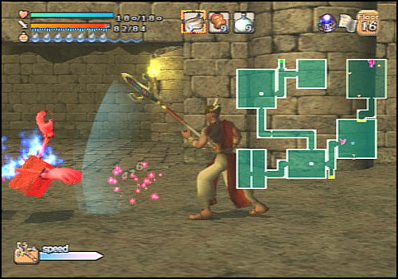
Time: Qualitative vs Quantitative Knowledge
Quantitative knowledge: How much is understood
Qualitative learning: How well it is understood
Qual: Knowing where the items are
Quan: Having the map
Notes:
Alright, let’s shift away from pacing and look at different types of knowledge, namely qualitative and quantitative knowledge. People say, “you get it or you don’t”, right? There’s no concept of “kind of get it?” First, let me ask you, what do you think these concepts mean? (if they say the above): Right, so what does that mean? How would you distinguish qualitative and quantitative knowledge? Right! So this an RPG map from my favourite game: Dark Cloud. In each dungeon level, two chests were designated for a dungeon map, which showed the layout of the floor. This is kind of like quantitative knowledge. Another chest would have a magic crystal which showed you where the monsters, doors, boost spots, and treasure chests on the floor were, in effect, the details of the map. That’s qualitative knowledge. To give a non-geeky example, it would be the difference of going to an enkai in a new neighbourhood and just following google maps, and being familiar with the neighbourhood it’s in and figuring out its location based on familiar landmarks and trajectories. So basically, already having a pre-existing conception of where it is.

Slide 12
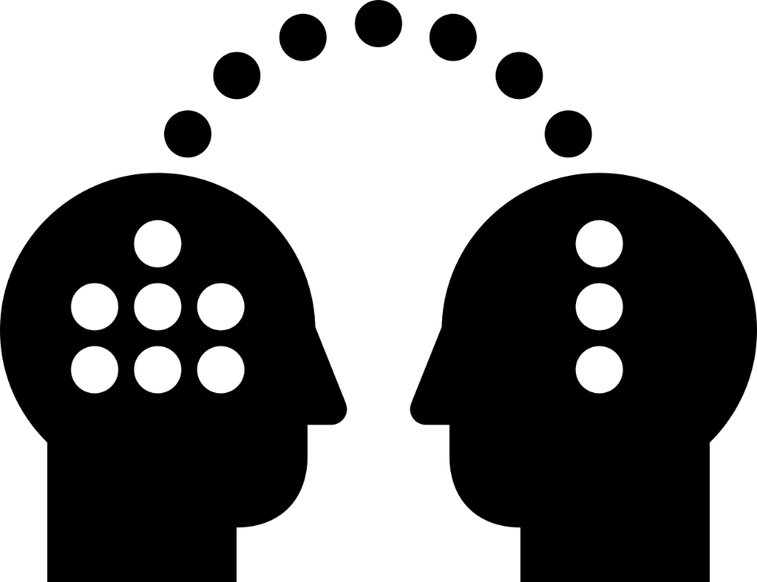
Time: Prior Knowledge
Learning:
Teacher
Student 1
Student 2
Student 3
Student 4
TOP
Notes:
Speaking of concepts… Learning is not the transfer of knowledge, but a reconstructing of alternative conceptions. :. Teaching requires an understanding of the range of learners’ prior conceptions and misconceptions. We often overlook this when we are used to speaking to native English speakers – we use metaphors, idioms, cultural references etc. that EFL learners can’t understand. Once we understand the students’ prior conceptions, we can work toward a preferred conception. How does this connect to the notion of Quan/Qual knowledge? Well, if we take the metaphor of an EFL student, a student with a quantitatively broad understanding will be someone who maybe has a broad vocabulary but poor writing. A students can qualtitatively improve their knowledge (a.k.a. better understand and articulate what they know) if they learn proper grammar. A teacher who has both a broad vocabulary, good grasp of grammar, and understands what the student knows and doesn’t know, can teach grammatical and natural ways to utilize the student’s vocabulary so they can express themselves given different contexts. What’s more, the teacher’s thorough, qualitative understanding gives them the possibility to guide the student from different perspectives and tie new knowledge to familiar concepts. The stronger the ties to prior knowledge (the stronger the connections), the less primary cognition is used to process the information, the more spare cognition can be used to think about and test the new information (against other prior understanding / further concepts), and the better the new information is retained.

Slide 13
Instructional: Organizing a lesson
Big questions
Graphic Organizers
Conceptual Frameworks / “hooks”
Threshold Concepts
Notes:
Does this mean that the more we slow down teaching the better they’ll understand it? So, one new word a day is the best, right? What are some reasons that wouldn’t work? (eg. If the pace is too slow, students lose motivation, don’t think about the new knowledge (because they don’t see how it advances their understanding). Making more, stronger links to new knowledge requires time, and if the information pieces are insignificant, out of context (or not significant to a context), then time will not be taken to reflect on them). So we have to find a good range of information to present. We’ll talk more about that later when we get into the Zone of Proximal Development, but for now, I want to point out that the way we present information has a huge influence on how well it is understood and retained. If a lesson is well organized, it is i) easier to understand the flow and continuity of information even across lessons, ii) it is easier to overlap with their own prior conceptions, and iii) more information can be presented at once, because students can prioritize and consequently compartmentalize the new information. Some ways that I’ve learned to organize a lesson are: - Start with a big question, one that is relevant to them, and possibly a little abstract or difficult to answer simply. For example, if we’re doing a unit on professions (in your English class of course), then what kind of question might you ask? (“Why do students in Japan learn English?” Or “How can you prepare for a future you don’t know?” or “What can you do to become a happy person?”) Right. The idea is to pick something that is relevant to all of them, even if all the individual information in the unit isn’t, and show them it’s connected. - Graphic organizers. You guys know this one: Venn Diagrams, concept maps, ishikawa diagrams, circle charts, flow charts, whatever. Considering the spatial presentation of information goes a long way in improving understanding.
- Conceptual frameworks are skeletons of information, kind of like a concept map. I used one here: I organized the information I wanted to present to you into the four factors of the classroom environment: Physical, Time/Instructional, Behavioural, and Teacher effectiveness. Instead of a bunch of loosely connected concepts, I did this so you could see how all the information ties into it’s category, and then into the overall concept. Basically, this helps students see the details without losing sight of the big picture. It can be chronological and divide connected events as chapters, it can be different perspectives of people involved in an issue. For the MLK Jr. unit, you could organize it as Power and talk bout how the imbalance of power happened and was maintained, Peace as something that can contrast what white people and African-American people thought that meant, and Protest, how it was done, documented, viewed, and so on. To wrap up, connect it to issues prevalent today and use an organizer to compare what is different and the same, or compare it to a current social issue in Japan. Students compartmentalize what they’re learning as a Power, peace, or Protest issue, they can look at case studies from all three points, and so on. A much stronger qualitative and quantitative understanding can be achieved if the information is organized. - Lastly threshold concepts are simplified, temporary ideas that help further students’ knowledge without overloading them. These are usually changed later. Remember when in high school you learned that the MRSP is not actually “how much something is worth”? That gravity is a lie? That the “I before e, except after c” rule is broken almost as often as it’s followed? That there is actually no such thing as “cold”? That atoms don’t actually move in lines around atoms, but exist in clouds of “likely locations”? Yeah physics is the biggest offender when it comes to threshold concepts that don’t check out later. But when you learn those overly-simplistic ideas, they help you further other, more detailed knowledge. So threshold concepts are changeable, temporary ways to quantitatively gain knowledge intended to be qualitatively improved later. The biggest one relevant to us is teaching students to “sound it out” which doesn’t check out for most English words but helps them with phonology and to understand the makeup of words. Alright, so looking at what we covered in Pacing/Instructional, I want you to try in pairs or groups of 3 people to think about how you would prepare two lessons for JHS 2nensei about the tenseless infinitive as a marker of intention (e.g. I go to my room to play videogames). Each lesson is 45 min. I don’t need you to tell me exact times of things, but give me the overall framework, some prior concepts you’d tie it to, how you would present it, and what kind of activities you’d do. We’ll talk about them after and try to form a consensus. OK so, you made a framework. What if I asked you to think about what medium you’d present it in? What resources would you use?

Slide 14
Instructional: Continuity
Refers to both connections between lesson topics, as well as review of information
Approaches to learning:
Surface Approach:
Focus on the signs (e.g. textual clues)
Focus on discreet elements
Memorize information and procedures for assessments
Unreflectively associate concepts and facts
Fail to distinguish principles/evidence, new/old info
Treat tasks as external imposition
Have an external emphasis (driven by external assessments, knowledge non-contextual)
Deep Approach:
Focus on what is signified (text meaning)
Relate/contrast new/old knowledge
Relate concepts to everyday practice
Distinguish evidence/argument
Organize and structure content
Have an internal emphasis (driven by personal / immediate reasons for learning)
Long-term retention
Notes:
I noticed a lot of you made a point of reviewing the previous lesson’s content before beginning the new lesson on day 2. Why’d you do that? Continuity in lessons refers to connections between lessons, be it to a new unit, a new focus, or a previous grade. It also refers to continuous retrieval of known information, i.e. review. We mentioned earlier that the more new information is processed, the better it is retained, because they are making connections to prior knowledge. In a sense, they are building their own continuity. We’re going to step away from that for a second and look at two different approaches to learning. And it’ll tie back into continuity in a moment but the first one is a surface approach. This is memorizing information, learning for a grade, for the test, to win a competition, and so on. Essentially, a surface approach is when students treat learning as a means to an end. Usually, that information is not retained after the external motivation is filled. A deep approach on the other hand, is when students focus on what the author is trying to say, when they are getting new information they’re cross-checking it against what they know, they’re relating it to everyday concepts… basically, learning is the end goal. This is when students are immersed in the content and proactively engaging with it. This is the kind of learning that results in long-term retention. Mostly, we talk about these two as a matter of student motivation, but short-term and long-term retention can also be influenced by the teacher. One technique for long-term retention is something called test-enhanced learning. You already do this, in some form or another probably.

Slide 15
Instructional: Test-enhanced learning
Assessment of learning
Answers marked but not necessarily given CF
At clear divisions or ends
High-stakes
Assessment for learning
Always includes corrective feedback
Frequent and spaced out over time
low or no-stakes
encoded or decoded
Notes:
I know I just mentioned that students studying to the test results in a surface approach to learning. In this case, “test” and “assessment” are synonymous, and the goal is just to pass the assessment. In this case, test are an “assessment of learning” and not “for the purpose of learning”. To compare what makes test-enhanced learning different from traditional testing, I want to ask you all some key questions. First: Is corrective feedback necessary for learning? Keep in mind what we learned about learning as alteration of conceptions. (Anyone who’s tried to speak Japanese and made the same mistake repeatedly only to be told a decade later it’s wrong better be saying yes right now). Ight, so: Do students get feedback from personal review and studying? No. Personal review is just to reinforce what they already understand; seldom does it give us a means to check our understanding against another conception. Multiple Choice is the devil. So testing with feedback gives students a chance to confirm their understanding. Second question: which ones require students to think about information more: a unit test, or weekly quizzes? (Some might argue that weekly quizzes are temporally close to the initial lesson so students might not feel the need to study. To this I say that no one said the quizzes are only on content learned that week. If they argue that quizzes aren’t high-stakes enough to encourage studying, accuse them of jumping ahead and also being presumptive about students). I dunno about you guys, but when we had a new science unit, I never reviewed the things I learned until we got a review before the unit test, and just studied to the test, then forgot most of it the next day. But if we had had weekly quizzes that asked questions from recent lessons as well as some information from a few lessons back, even with the test paper in front of me, I’d be forced to think back to that information, making it easier to recall later. So, in order for testing to benefit learning, it has to be frequent and spaced out enough that students are forced to recall what they learn both shortly and quite some time after learning it (the best part is, this will also make it easier for them to recall it on unit tests later). In my school, after exams, the teachers take some class time to go over all the answers to the questions as a class with students, explaining them. This is feedback, which s great, but unless the students get a chance to use that knowledge again, to review it again maybe on a future test, then it’s not going to stick, and definitely not from just oral explanations. Ight last question, super easy: which one is more likely to encourage students to take a deep approach to learning: weekly quizzes worth just 2% each, or a unit test worth 20% of their final grade? In other words, which one is going to make them “study to the test” and with which one are they more likely to allow themselves to deviate from the course content to something related that interests them? The small one, right? Because they’re not worrying about having to get a high mark or make sure they answer exactly as the teacher expects. In other words, the unit test is high-stakes, which demands a surface approach to learning (studying as a means), and the quizzes are low-stakes, so learning takes a front seat. Researchers of test-enhanced learning all stress that it’s essential that testing be low or no-stakes. Do you guys do any no-stakes testing in your classes? (columns and rows, for example) Exactly! That’s literally an oral test with no repercussions for wrong answers. If you asked students also to get creative with it and give them chances to work with what they learned (i.e. not questions with absolute answers), it would be even better. The trade-off with that game is that it encourages the whole class because they’re affected by their classmates’ answers, but it also means that kids who don’t want to participate don’t necessarily have to, as long as they can find a way to sit down by someone else’s response. But we’re splitting hairs here. The takeaway is that it greatly benefits learners to have frequent and spaced review with little to no-risk and corrective feedback.

Slide 16
Instructional: Reflection
Journaling
Letter exchanges
Writing warm-up
Exit slips
Answering the Big Question
3-2-1
Elimination facts
Notes:
Of course, teacher-guided and decided test-enhanced learning isn’t the only way to review material; someone mentioned earlier that even reviewing it by themselves is a way to think on what they learned and retain it. You’re right. So we’re going to talk about reflection strategies; different ways of getting students to think about what they learned. Are there any reflection strategies you have at your school, either as a class or even with individual students? Does anyone do journal exchange with their students? Do you or they try to include vocab or grammar points that they recently learned? Some people to letter exchanges; those are a good form of delayed review. I don’t do journaling per se, but at the start of each lesson, I give them a creative question to think about and 5 minutes to write as much as they can about it. At the end of the term, I ask them to go back and look at what they wrote from the beginning, so they can see how much they’ve improved, if they see any mistakes they made, etc. It would be more effective if they wrote about what they remember from the previous lesson, or write at the end about what they learned, but like, these are still kids and I’m prioritizing student motivation and creativity here instead of maximising retention. If you want to go that route, one thing you can do is have the students write “exit slips” at the end of each lesson. They write one thing they learned, and one thing they still think they don’t understand well. At the beginning of the next class, address those weak points. One thing that I’ve done in class with some success is to bring back the big question that was introduced at the beginning of the unit and have them try to answer it with their new knowledge. If you give them some time where they have to talk as much as they can with their parent about that question and fill the time, or if they’re not at that level yet, write as much as they can or draw a concept map to try to illustrate their answer with disjointed words, it makes them think about the knowledge as a whole and solidify how everything is organized in their brains. This tends to go better if they can work in pairs and fill in the memory gaps for each other. The last two I want to mention are related. First is an exercise you can do at the end of a unit on the day after the exam or a test. Each student writes down 6 things: 3 things they think they know, 2 things they’re uncertain of, and 1 thin they’re still curious about. Collect it, read it, enjoy. Or swap them with a classmate and have them try to teach each other. The other thing I like to do is called elimination facts. It starts the same: each student has to write down 3 things they learned. Then they pair up. Anything they wrote down that is the same as their partners is eliminated, and they have to try to get back up to 3 again, with each having 3 unique ideas. If your kids are capable of it, put them in groups of 4, check for overlap and eliminate it. Between the four of them, tell them they have to come up with 8 unique things. At this point it might be a bit difficult unless it’s like a whole=year reflection, so just ask each group to read what they came up with and throw it on the board. See how many overlap with other groups. You should end up with a nice running list of things they learned, and it’s a great visual for them. The most important thing is that you don’t tell the students what they learned; you let them tell you. This is a good way to assess how effective your teaching was, and at from what point you need to start.

Slide 17
Pop Quiz!
Which long-term retention strategy is best for elementary school 6th graders?
What’s the difference between conceptual frameworks and threshold concepts?
A tourist is lost at Sannomiya station and trying to get to Ikuta shrine. Google Map’s GPS isn’t syncing correctly. Give one example of quantitative teaching, and one of qualitative teaching.
Which of these colours would be most effective as a slideshow background in your 5th period lesson?
TOP

Slide 18
Teacher impact: Soft skills
Hidden curriculum: the teaching of social, cultural, behavioural norms, values, and beliefs not openly intended to be taught or traditionally assessed
Include: How to act in a group, morals, habits, hierarchical divides and the preservation of social privileges
Notes:
Last factor, and personally, since I am self-centered, this one is my favourite. How many people here have heard of the hidden curriculum before? (as long as it’s not everyone, give a definition). Nice! Ok, quite a few. It’s the “hidden” stuff we learn at nijikai after our coworkers have downed enough spirit, right? No, so what is it? …basically, it’s the things not in the textbook that students learn from watching teachers’ behaviour. Now because of how infrequently some of you may see your kids (both in class and around the school), or how they think of you, you might have a lot of influence over this, or you might have none. That’s dependent on the student, but what does depend on you is what you want them to learn from you. If you came to my seminar two years ago, thanks for giving me another chance, but I talked about forming the kind of persona you want to be seen as in the workplace. This is definitely 100% that. You want your students to be punctual? You’re not gonna inspire that in them if you stroll into class after the bell. Want to break the stereotypes your culture has in Japan? Make an active effort not to act on them. Don’t be a stereotype. Want them to write neater? Make a point of having neat writing yourself (correct your writing in front of them), overtly praise good writing. I want to be a good teacher, make my lessons fun and effective. I have a reminder quote written on the outside of all my binders, and make a point of finding 1-2 students from my class earlier that day and asking how the lesson went, or asking what their most fun class that day was, and why it was fun. I get them to help me with studying Japanese, partially because I don’t want to always bother coworkers, partly because it’s a fun way to interact, and also partly because it shows them that I’m trying hard in my studies, too. Empathy is something they can learn from you too. You do you, but when you do, keep in mind they’re always learning from you.
I know you guys are probably thinking “Ight but the slide title is “soft skills” not “hidden curriculum” Basia did you make a mistake” and no, no, I’m getting there now. The things your kids are learning are i) the content of the lesson, ii) the “hard skills” of the medium (that is, English reading, writing, listening, and speaking), iii) the hidden curriculum stuff, and iv) the soft skills. (you can see why this takes so much more cognitive capacity for them, eh?) So, name me some soft skills: (creativity, critical thinking, recognizing unknowns, initiative, public speaking/participation analyzing perspectives)

Slide 19


Teacher Impact: Zone of Proximal Development (ZPD)
“The zone between what a learner can do independently…and what cannot be done safely, even when assisted by a more competent member of the community” (Lave & Wenger, 1991, via Pratt & Smulders, 2016)
Content-based, independent of learner autonomy
On the dependence-independence continuum: “far enough to challenge the learner, but not so far as to cause frustration and self-doubt”
Exists for hard / soft skills too
Notes:
[give them the anecdote of undokai in Malawi and the biomimicry exercises] - warm-up activities are a great place to test the waters regarding the skills you want them to employ in upcoming lessons. For example, giving a debate task to a class that does not interact well with each other, or with low critical thinking skills might not go over well. Similarly, if you opened the MLK Jr. lesson with “brainstorm reasons for why some people supported the power imbalance between whites and blacks”, you’re not going to get much to work with. How about you guys? Any lessons that didn’t go over well because maybe they demanded too much critical thinking or creativity or public speaking or initiative?

Slide 20
Teacher impact: Self-improvement
Student feedback
Post-lesson reflection questions
What worked? Why?
What didn’t work? Why?
Was the sequencing of material appropriate and helpful?
Was the pace appropriate?
What would you do the same next time?
What would you do differently?
Notes:
I mentioned this already but I make a point of finding students after the classes I teach and asking them about how the lesson went. Not just the students who participated, but asking the ones who slept or didn’t seem that engaged too: there’s a lot more to learn there. Don’t ask the same kid every time; it’ll give you an inaccurate impression of how your lessons are being received, plus they might get annoyed after a while and just give you dismissive answers. Asking your co-teacher and watching their reactions to your lesson is a good way to learn too. But asking students directly is the best way to find out how to make it better for them next time. Aside from that, there are a series of self-reflective questions I ask myself, either after each class, or at the end of the busy day. The sooner the better of course, because everything is still fresh in your mind. They sit on a sticky-note on my desk.
[go through the questions]
It can also help to talk it over with your OTE or other ALTs. Personally, I discuss my classes in the education courses I’m taking and with past professors. And if there are any concrete answers to improve your lesson next time, write it down. Leave yourself a note. Plan to meet with your co-teacher if it’s something they can help you fix, like seating arrangements or classroom resources. The point is, note your reflection somewhere so that when you’re preparing for your lesson again, you have it on your mind going in.

Slide 21
“What was learned is more important than what was taught.”
ー Daniel D. Pratt & Sandra Jarvis Selinger

Slide 22
References and suggested readings
https://rdw.rowan.edu/cgi/viewcontent.cgi?article=2089&context=etd
https://files.eric.ed.gov/fulltext/EJ1152568.pdf
https://www.researchgate.net/publication/243771420_Classroom_organization_and_management
https://www.jstage.jst.go.jp/article/etr/34/1-2/34_KJ00007561986/_article
https://cei.umn.edu/teaching-active-learning-classroom-alc
https://globaldigitalcitizen.org/15-retention-strategies-remember-learning
Pratt, Daniel D., Smulders Dave et al. “Five Perspectives on Teaching: Mapping a Plurality of the Good.” Second ed. Krieger Publishing Company. 2016.

